Slide 1

Naming things is hard

Slide 2
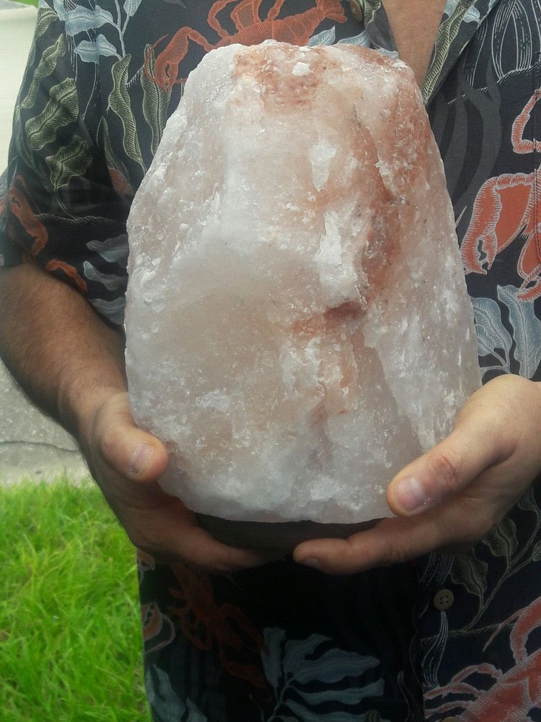
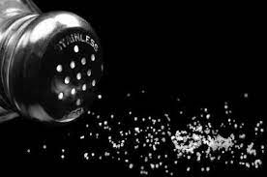
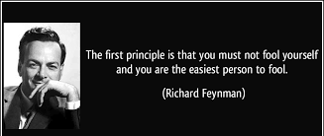
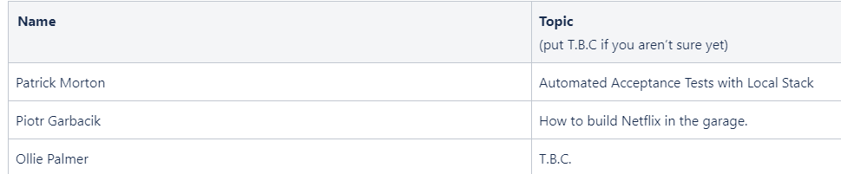
Naming things is hard
float currentx1ToTopVertDist = getDistBetweenTwoPoints(
triVert1,
CanvasPoint(currentx1, scanlineY)
);
/* trivial case of bottom-flat triangle */
float bottomFlatTopToBottomInvSlope … ;
Notes:
Why take advice from the guy who couldn't even think of a name for this talk?
Embarrassing - uni comp graphics
3000 lines of code
Disclaimer
longest most uninformative variable names
unhelpful comments
To name well - you have to really understand it and distill that information.
"Don't fool yourself and you are the easiest person to fool.”
salt

Slide 3



Content has been stolen borrowed from this very useful article:
“Ten Commandments For Naming Your Code” – Matthew Jones
Condensed & informative
Notes:
Happy to know it's not my advice – programmer of 10+ years exception not found blog

Slide 4
Rule #1 Thou shalt be specific.
Naming a baby
John
John Smith
X Æ A-12
Notes:
John
John Smith (surname)
be specific

Slide 5
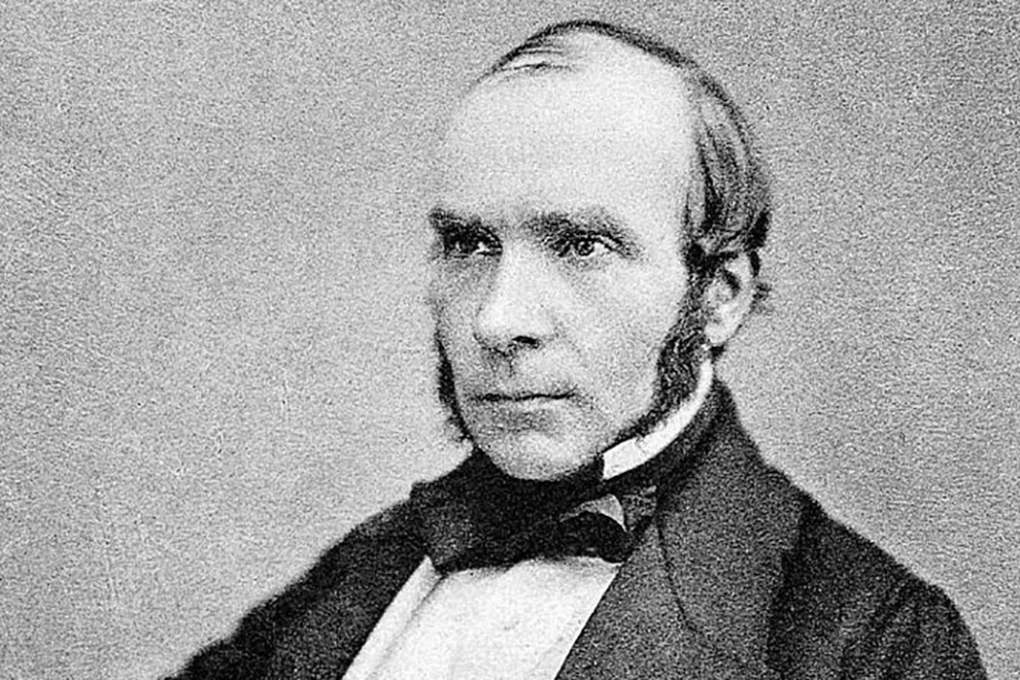

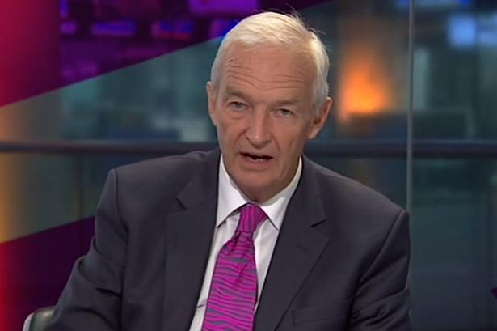
Rule #2 Thou shalt not use unnecessary words.
Context matters
JonSnowPresenter
JonSnowGameOfThrones
JonSnowWhoKnowsNothing
JonSnowEpidemiologist
JonSnow
Notes:
If I said Jon Snow in conversation

Slide 6
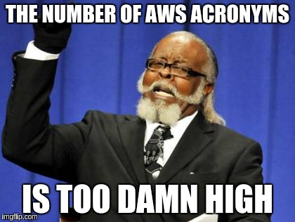
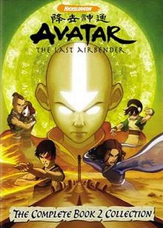
Rule #3 Thou shalt not use abbreviations.
XNA
ADR
TLA
XNA’s Not Acronymed
Architectural Decision Record
American Depository Receipt
Accord européen relatif au transport international des marchandises Dangereuses par Route
Three-Letter Abbreviation
Three-Letter Acronym
Term Loan A
Text Link Ads
The Last Airbender
TSNUA
Time Sensitive Networking with Unified Architecture
Thou Shalt Not Use Abbreviations
Notes:
If acronym is well known within team its fine
Bonus acronym
XNA recursive

Slide 7

Biology Throwback
“
”
Notes:
Did bio at uni
20 authors, peer reviewed
not one questioned acronym

Slide 8
Rule #4 Thou shalt use the code's primary human language.
Ciao mondo!
你好世界！
こんにちは世界！
Привет мир!
Olá Mundo!
مرحبا بالعالم!
Hej världen!
Notes:
Inherit a codebase that is all in Arabic – better get learning.

Slide 9

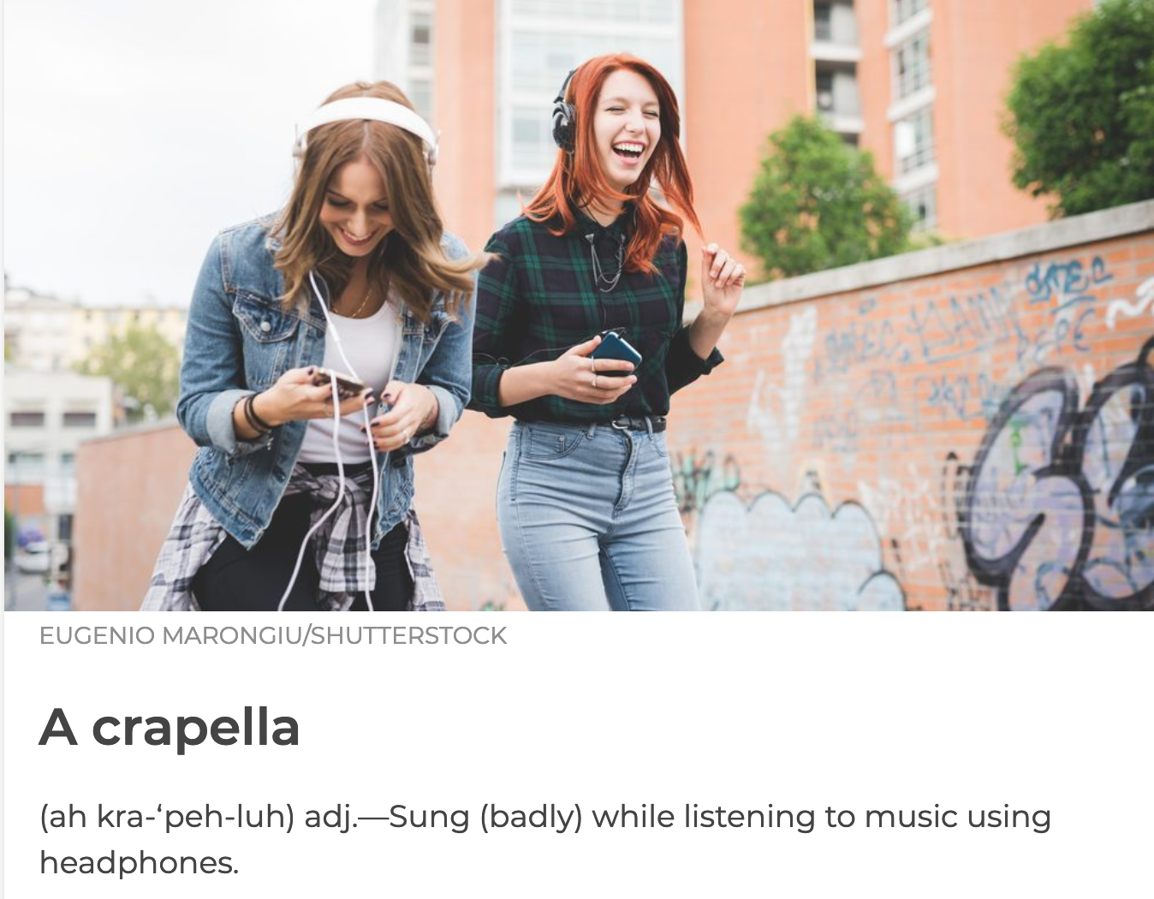


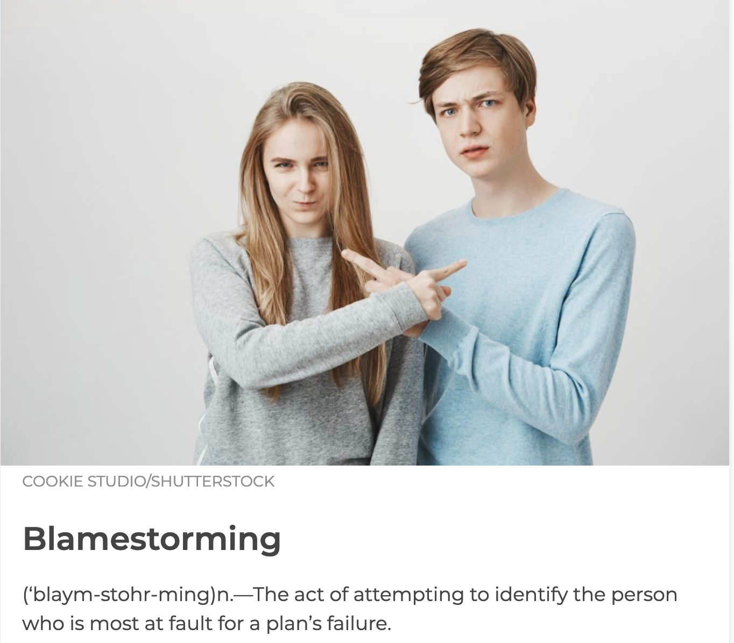
Rule #5 Thou shalt not make up words.

Slide 10
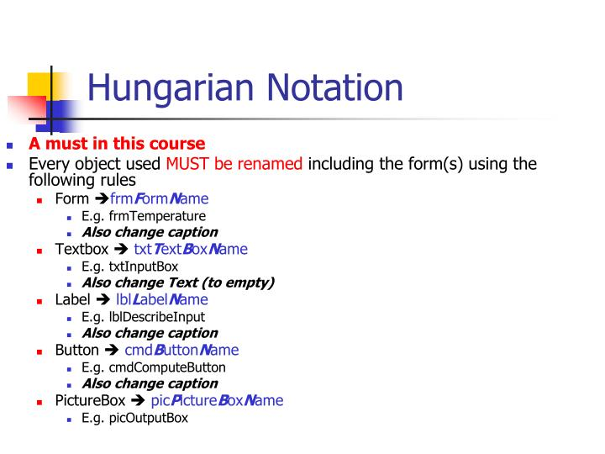
Rule #6 Thou shalt not include type.
strName = “Ollie”
arru8NumberList = […]
Notes:
called hungarian notation
doesn't add anything

Slide 11

Rule #7 Thou shalt only use non-obvious words if the meaning is obvious.
Non-hyphenated
for(int x = 10; x >= 0; x--)
for(int greenBottles = 10; greenBottles >= 0; greenBottles--)
Phonetic
Notes:
iterators are fine to just be x
unless they have a non-obvious meaning can't otherwise be inferred.
learnt a new word for ’non-obvious’ - ironic
ranks up there in irony with one of my favourite words
English language

Slide 12
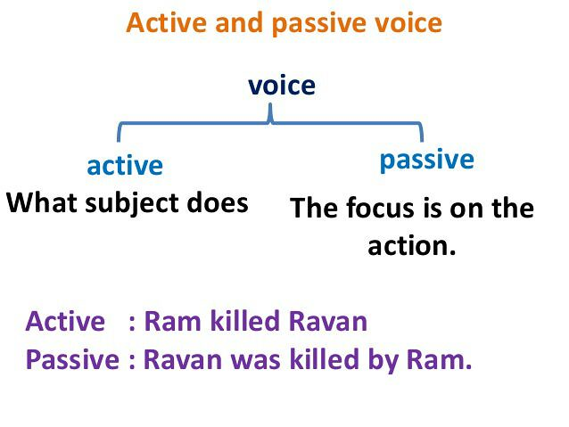
Rule #8 Thou shalt prefer active voice.
Active voice shows that an action is being done by an object
Transpile()
GetTranspiler()

Slide 13
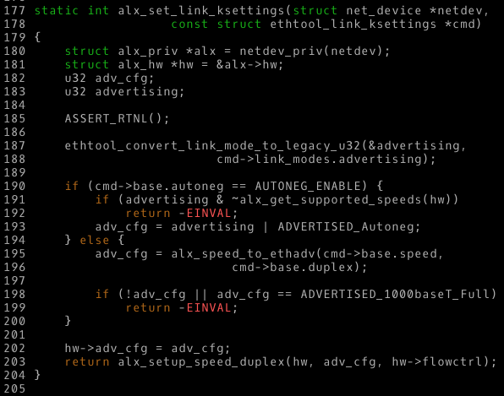
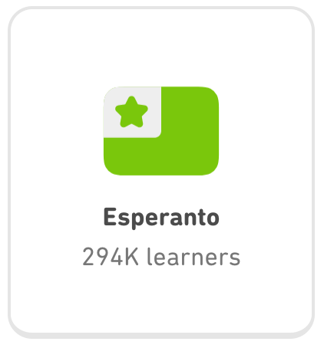
Rule #9 Thou shalt use consistent syntax.
Consistency > Optimal rules
Snake_case
Kebab-case
camelCase
PascalCase
sWAPcASE
period.case
P_a_r_s_e_d
MiXEdCaSe
IAL
Notes:
Being consistent is more important than trying to impose rules on a system that isn't using them already.
If you are in a position to change or influence the syntax rules so that they are more consistent (or more sane), do it.
Otherwise, make the suckrifice.
Consistent is more important.
Optimal not always most popular
look at languages Espiranto –
most widely spoken internationally auxiliary language IAL, auxlang)
who doesn't need another TLA to learn
simple, consistent, easy to learn
(1000 native, 63000-2 million)

Slide 14
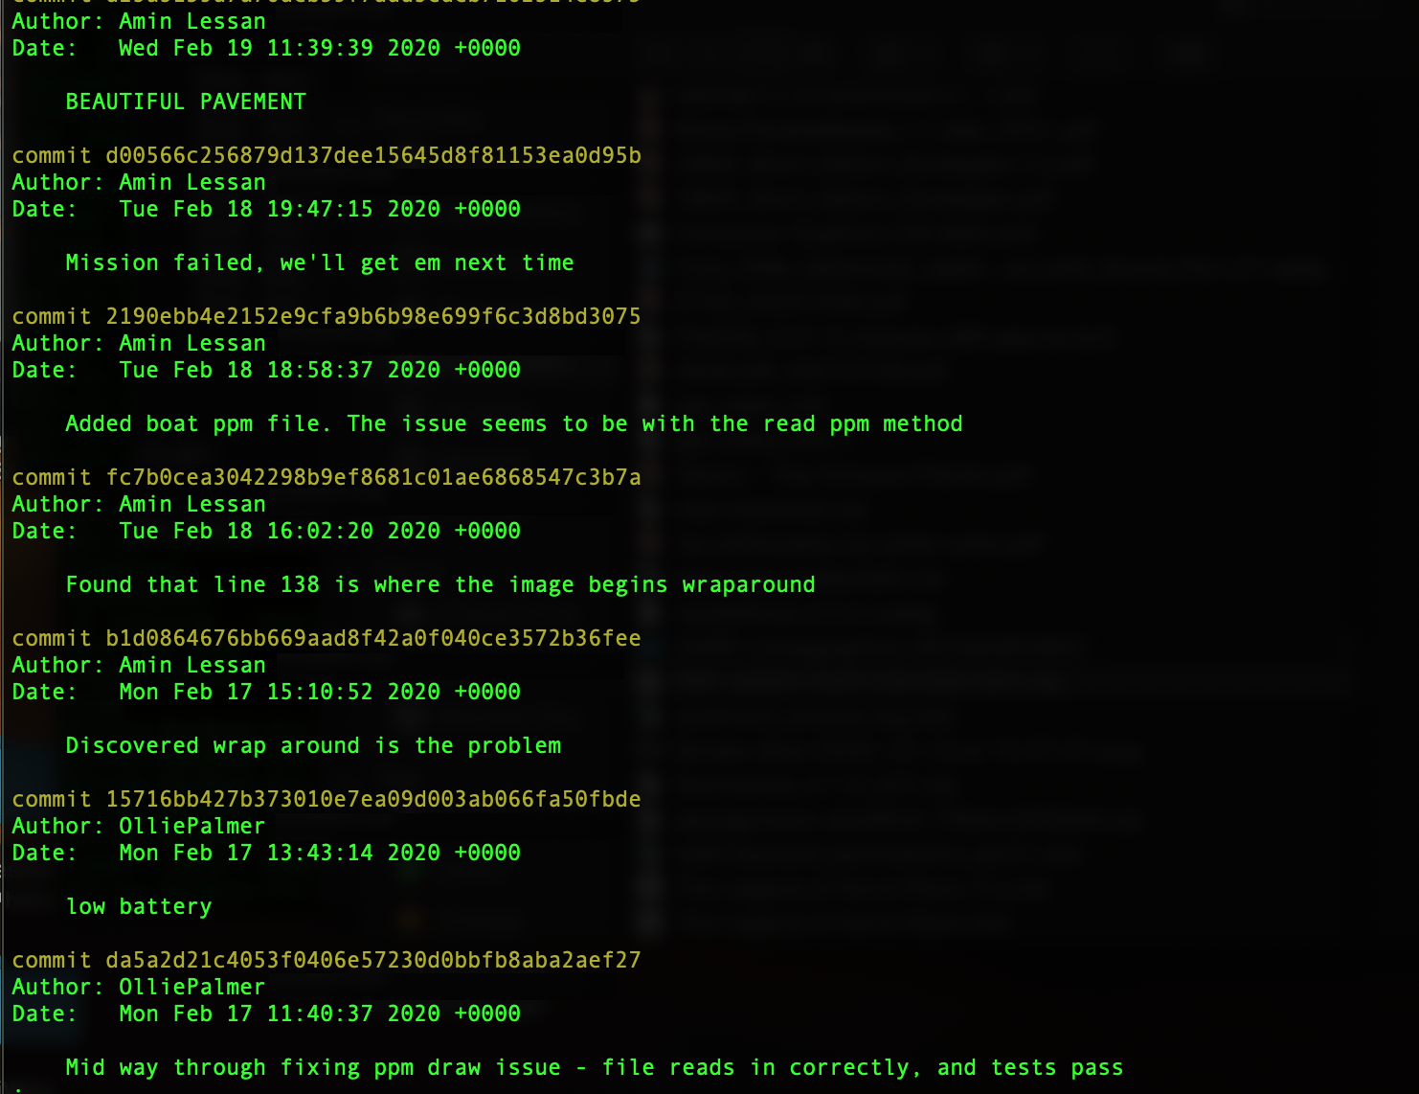

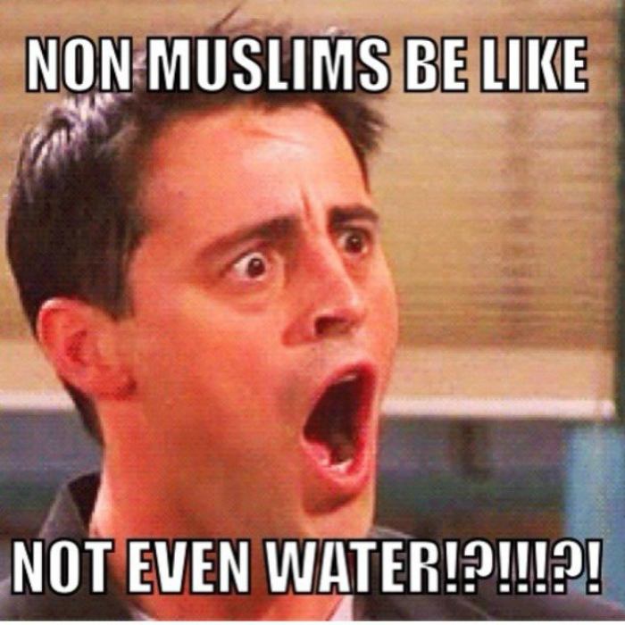
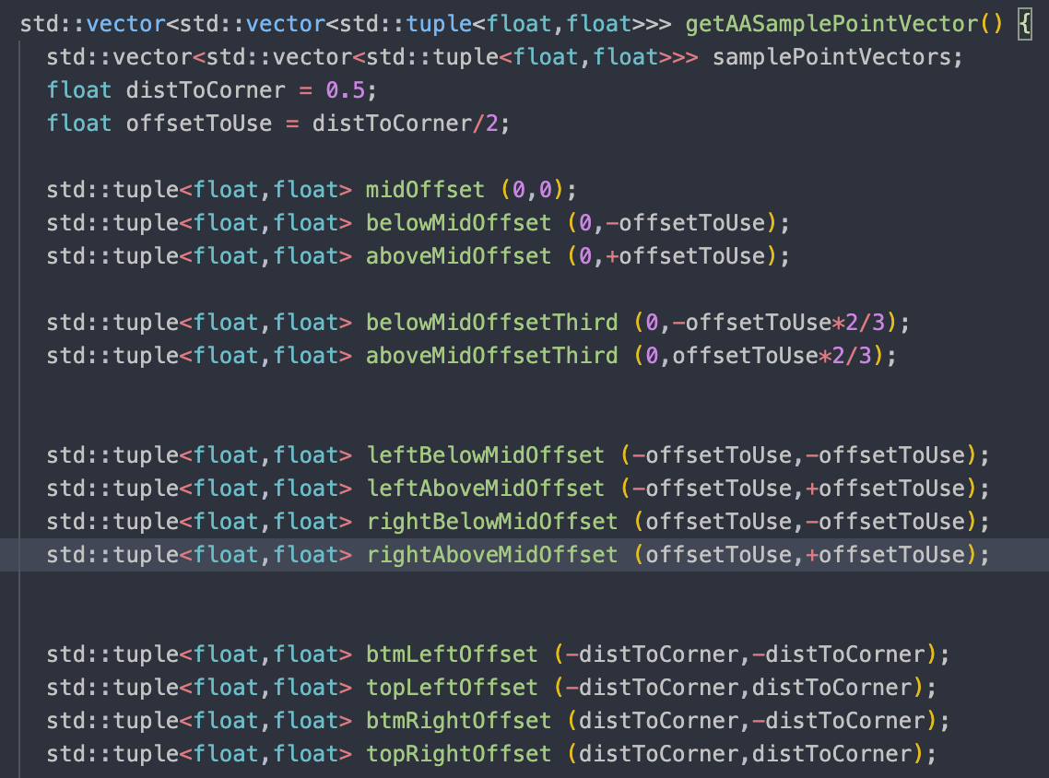
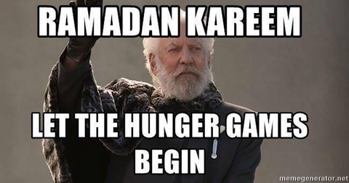
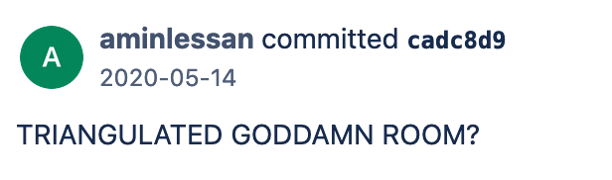
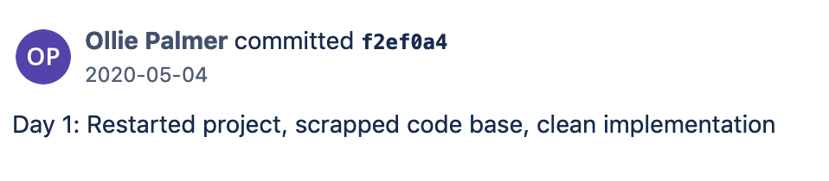
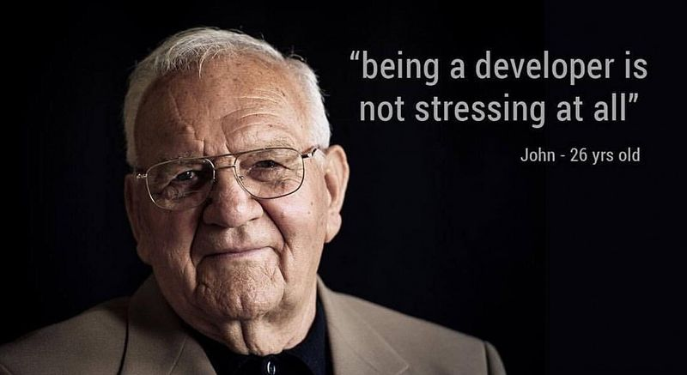

Rule #10 Thou shalt break these rules if necessary.
float currentx1ToTopVertDist = getDistBetweenTwoPoints(…);
/* trivial case of bottom-flat triangle */
float bottomFlatTopToBottomInvSlope … ;
Notes:
Limited time – computer graphics engine in 2 weeks – everything goes out of the window – including the computer

Slide 15
Recap
Thou shalt be specific.
Thou shalt not use unnecessary words.
Thou shalt not use abbreviations.
Thou shalt use the code's primary human language.
Thou shalt not make up words.
Thou shalt not include type.
Thou shalt only use non-obvious words if the meaning is obvious.
Thou shalt prefer active voice.
Thou shalt use consistent syntax.
Thou shalt break these rules if necessary.

Slide 16
Recap of the Recap
Thou shalt be specific when naming variables during software development particularly if the context is hard to determine.
Thou shalt not use unnecessary, superfluous, unneeded or useless words.
TSNUA
Você deve usar a linguagem humana primária do código.
Thou shalt not make up words, this unlightens everyone.
strThou_shalt_not_include_type.
Thou shalt only use esoteric words if the meaning is non-esoteric.
The active voice should be preferred by thee.
Thou shalt, use cOnSisTeNt syntax!?
You can break these rules if necessary.
Notes:
name notepad as a team
looks wrong - spelling -> tell when it's written down
temporary is permanent
-> get it right 1st time

Slide 17
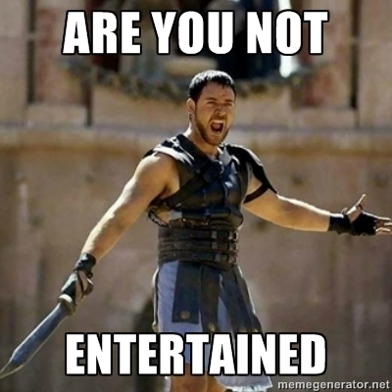
tl;dl;
be concise but specific
or
why use lot word when few do trick
Notes:
Thanks for coming

